Slide 1
statistics
Unit 1

Slide 2
Introductions
Statistics gives us methods of gaining knowledge from data.
Statistics gives us more accurate knowledge which helps us make better decisions.
Statistics can focus on making predictions about what will happen in the future. It can also focus on explaining how different things are connected.

Slide 3
Typical Steps of Statistical Methods
Gathering data
Describing and visualizing data
Making conclusions

Slide 4
How is Statistics Used?
Statistics can be used to explain things in a precise way. You can use it to understand and make conclusions about the group that you want to know more about. This group is called the population.

Slide 5
Important Concepts in Statistics
Predictions and Explanations
Populations and Samples
Parameters and Sample Statistics
Sampling Methods
Data Types
Measurement Level
Descriptive Statistics
Random Variables
Univariate and Multivariate Statistics
Probability Calculation
Probability Distributions
Statistical Inference
Parameter Estimation
Hypothesis Testing
Correlation
Regression Analysis

Slide 6
Comparison Chart between primary data and secondary data
primary data
secondary data
Primary data refers to the first hand data gathered by the researcher himself.
Real time data
Surveys, observations, experiments, questionnaire, personal interview, etc.
Expensive
Always specific to the researcher's needs.
Secondary data means data collected by someone else earlier.
Past data
Government publications, websites, books, journal articles, internal records etc.
Economical
May or may not be specific to the researcher's need.

Slide 7
Descriptive Statistics
Descriptive statistics are simply describing what is or what the data shows. With inferential statistics, you are trying to reach conclusions that extend beyond the immediate data alone. Descriptive Statistics are used to present quantitative descriptions in a manageable form. Descriptive statistics help us to simplify large amounts. Each descriptive statistic reduces lots of data into a simpler summary of data in a sensible way.

Slide 8
Types of descriptive statistics
There are 3 main types of descriptive statistics:
The distribution concerns the frequency of each value.
The central tendency concerns the averages of the values.
The variability or dispersion concerns how spread out the values are.
You can apply these to assess only one variable at a time, in univariate analysis, or to compare two or more, in bivariate and multivariate analysis.

Slide 9
Frequency distribution
A data set is made up of a distribution of values, or scores. In tables or graphs, you can summarize the frequency of every possible value of a variable in numbers or percentages.
We have three type of frequency distribution.
1) Individual Series
2) Discrete series
3) Continuous series

Slide 10
Measures of central tendency
Measures of central tendency estimate the center, or average, of a data set. The mean, median and mode are 3 ways of finding the average.

Slide 11
Mean (Direct method)
Arithmetic Mean of Ungrouped Data
If x1, x2, x3 ,……,xn be the observations with the frequencies f1, f2, f3 ,……,fn, then the arithmetic mean is given by:
x̄ = (x1f1+x2f2+……+xnfn) / ∑fi
where ∑fi is the summation of all the frequencies.

Slide 12
Assumed Mean Method
assumed mean formula = a + ∑di]fi / ∑fi,
where di = xi - a

Slide 13
Step Deviation Method
Step Deviation of Mean = a + h [∑uifi / ∑fi]
where
a is the assumed mean
h is the class size
ui= di/h

Slide 14
Practice question 1
Find missing frequency from the following data
Class Frequency
5 - 10 11
10 - 15 20
15 - 20 35
20 - 25 20
25 - 30 a
30 - 35 6
mean = 18.1

Slide 15
Practice question 2
An incomplete distribution is given below :
Variable: 10−20 20−30 30−40 40−50 50−60 60−70 70−80
Frequency: 12 30 − 65 − 25 18
You are given that the median value is 46 and the total number of items is 230.
(i) Using the median formula fill up missing frequencies.
(ii) Calculate the AM of the completed distribution.

Slide 16
Practice question 3
Find the missing frequency f 1​
and f 2 in the table given below, it is being given that the mean of the given frequency distribution is 50.
Class 0−20 20−40 40−60 60−80 80−100 Total
Frequency 17 f 1 32 f 2 19 120

Slide 17
Practice question 4
Find the mean percentage of the work completed for a project in a country where the assumed mean is 50, the class size is 20, frequency is 100, and the product of the frequency and deviation is - 42. Solve this by using the step-deviation method.

Slide 18
Given,
a = 50, h = 20, fi = 100, fiui = - 42
Using the step deviation method formula,
Step Deviation of Mean = a + h [∑uifi / ∑fi]
= 50 + 20 [-42/100]
= 50 - 42/5
= 50 - 8.4
= 41.6
Therefore, the mean percentage is 41.6.

Slide 19
median
he median is the middle value in a set of data. First, organize and order the data from smallest to largest. To find the midpoint value, divide the number of observations by two. If there are an odd number of observations, round that number up, and the value in that position is the median.

Slide 20
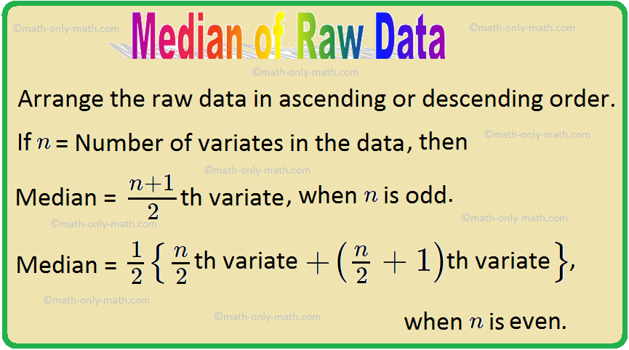
For individual series

Slide 21
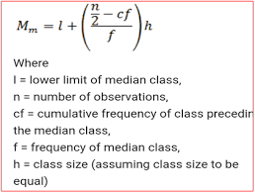
For continuous series

Slide 22
Practice question
Find the median of the following data.
(a) 27, 39, 49, 20, 21, 28, 38
(b) 10, 19, 54, 80, 15, 16
(c) 47, 41, 52, 43, 56, 35, 49, 55, 42
(d) 12, 17, 3, 14, 5, 8, 7, 15

Slide 23
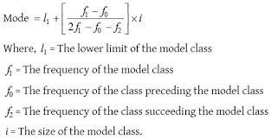
mode

Slide 24
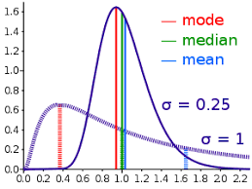

Slide 25
Univariate descriptive statistics
Univariate descriptive statistics focus on only one variable at a time. It’s important to examine data from each variable separately using multiple measures of distribution, central tendency and spread. Programs like SPSS and Excel can be used to easily calculate these.

Slide 26
Bivariate descriptive statistics
If you’ve collected data on more than one variable, you can use bivariate or multivariate descriptive statistics to explore whether there are relationships between them.
In bivariate analysis, you simultaneously study the frequency and variability of two variables to see if they vary together. You can also compare the central tendency of the two variables before performing further statistical tests.
Multivariate analysis is the same as bivariate analysis but with more than two variables.

Slide 27
Statistical Sampling and Resampling
A Gentle Introduction to Statistical Sampling and Resampling
by Jason Brownlee on June 13, 2018 in Statistics
Tweet Tweet Share
Last Updated on August 8, 2019
Data is the currency of applied machine learning. Therefore, it is important that it is both collected and used effectively.
Data sampling refers to statistical methods for selecting observations from the domain with the objective of estimating a population parameter. Whereas data resampling refers to methods for economically using a collected dataset to improve the estimate of the population parameter and help to quantify the uncertainty of the estimate.
Both data sampling and data resampling are methods that are required in a predictive modeling problem.

Slide 28
Statistical Sampling
Each row of data represents an observation about something in the world.
When working with data, we often do not have access to all possible observations. This could be for many reasons; for example:
It may difficult or expensive to make more observations.
It may be challenging to gather all observations together.
More observations are expected to be made in the future.

Slide 29
Sampling Errors
Two main types of errors include selection bias and sampling error.
Selection Bias. Caused when the method of drawing observations skews the sample in some way.
Sampling Error. Caused due to the random nature of drawing observations skewing the sample in some way.

Slide 30
Statistical Resampling
Once we have a data sample, it can be used to estimate the population parameter.
The problem is that we only have a single estimate of the population parameter, with little idea of the variability or uncertainty in the estimate.
One way to address this is by estimating the population parameter multiple times from our data sample. This is called resampling.
Statistical resampling methods are procedures that describe how to economically use available data to estimate a population parameter. The result can be both a more accurate estimate of the parameter (such as taking the mean of the estimates) and a quantification of the uncertainty of the estimate (such as adding a confidence interval).

Slide 31
Two commonly used resampling methods that you may encounter are k-fold cross-validation and the bootstrap.
Bootstrap. Samples are drawn from the dataset with replacement (allowing the same sample to appear more than once in the sample), where those instances not drawn into the data sample may be used for the test set.
k-fold Cross-Validation. A dataset is partitioned into k groups, where each group is given the opportunity of being used as a held out test set leaving the remaining groups as the training set.

Slide 32
Sampling Distribution
Sampling distribution in statistics refers to studying many random samples collected from a given population based on a specific attribute. The results obtained provide a clear picture of variations in the probability of the outcomes derived. As a result, the analysts remain aware of the results beforehand, and hence, they can make preparations to take action accordingly.

Slide 33
Types of distributions
There are three standard types of sampling distributions in statistics:1.
Sampling distribution of mean
The most common type of sampling distribution is the mean. It focuses on calculating the mean of every sample group chosen from the population and plotting the data points. The graph shows a normal distribution where the center is the mean of the sampling distribution, which represents the mean of the entire population.

Slide 34
2. Sampling distribution of proportion
This sampling distribution focuses on proportions in a population. You select samples and calculate their proportions. The means of the sample proportions from each group represent the proportion of the entire population
3. T-distribution
A T-distribution is a sampling distribution that involves a small population or one where you don't know much about it. It is used to estimate the mean of the population and other statistics such as confidence intervals, statistical differences and linear regression.

Slide 35
Graphs in statistics
The four basic graphs used in statistics include bar, line, histogram and pie charts. These are explained here in brie

Slide 36
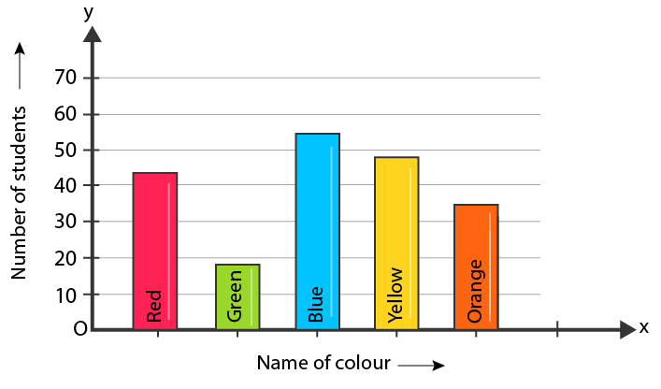
Bar Graph
Bar graphs are the pictorial representation of grouped data in vertical or horizontal rectangular bars, where the length of bars is proportional to the measure of data. The chart’s horizontal axis represents categorical data, whereas the chart’s vertical axis defines discrete data.
Bar graph

Slide 37
Line Graph
A graph that utilizes points and lines to represent change over time is defined as a line graph. In other words, it is a chart that shows a line joining several points or a line that shows the relation between the points. The diagram depicts quantitative data between two changing variables with a straight line or curve that joins a series of successive data points. Linear charts compare these two variables on a vertical and horizontal axis.

Slide 38
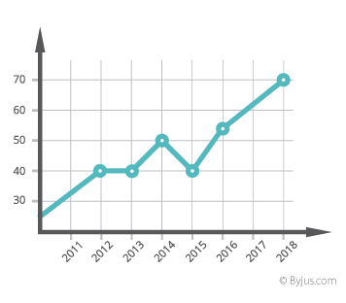

Slide 39
Histogram
A histogram chart displays the frequency of discrete and continuous data in a dataset using connected rectangular bars. Here, the number of observations that fall into a predefined class interval represented by a rectangular bar.

Slide 40
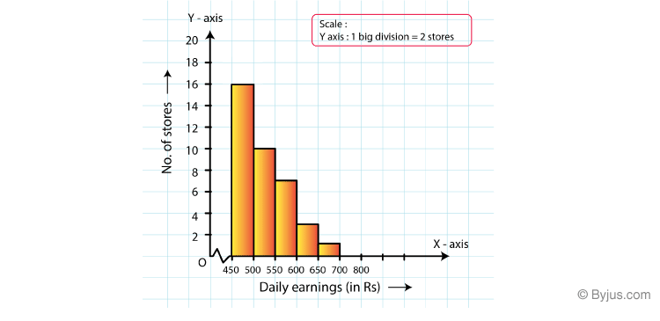

Slide 41
Pie Chart
A pie chart used to represent the numerical proportions of a dataset. This graph involves dividing a circle into various sectors, where each sector represents the proportion of a particular element as a whole. This is also called a circle chart or circle graph.

Slide 42
